Slide 1
Predicting PSA Levels Using Linear Regression

Slide 2
Objective:
Build a regression model to predict PSA levels (Y) as a function of cancer volume (X).
Addressing whether key regression assumptions hold for the regression model.
Applying remedial measures if assumptions are violated and finalizing model.
Using final model to predict to PSA level for given Cancer Volume.
Evaluating Model’s strengths and weaknesses.

Slide 3
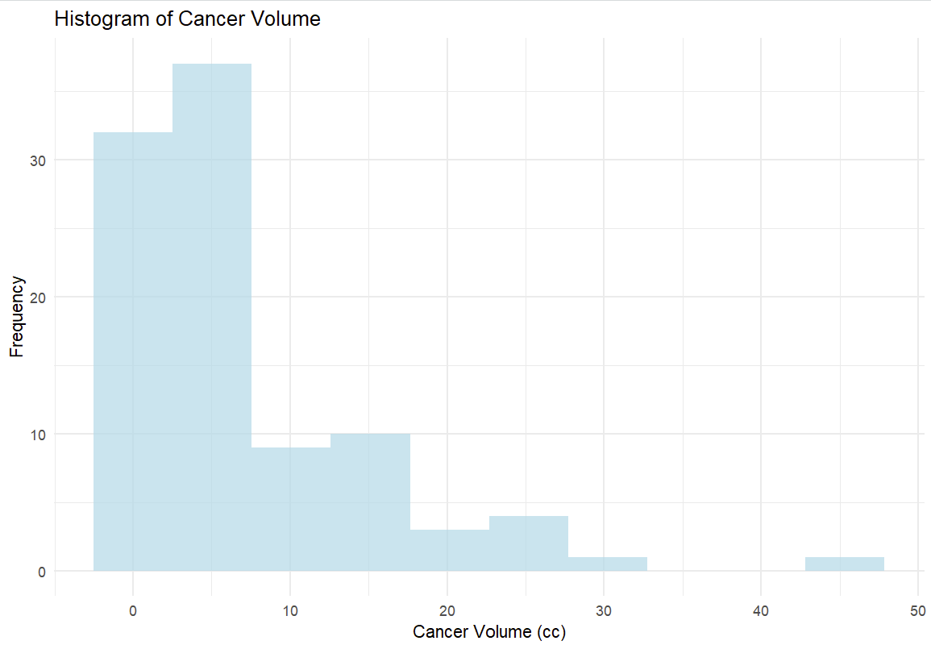
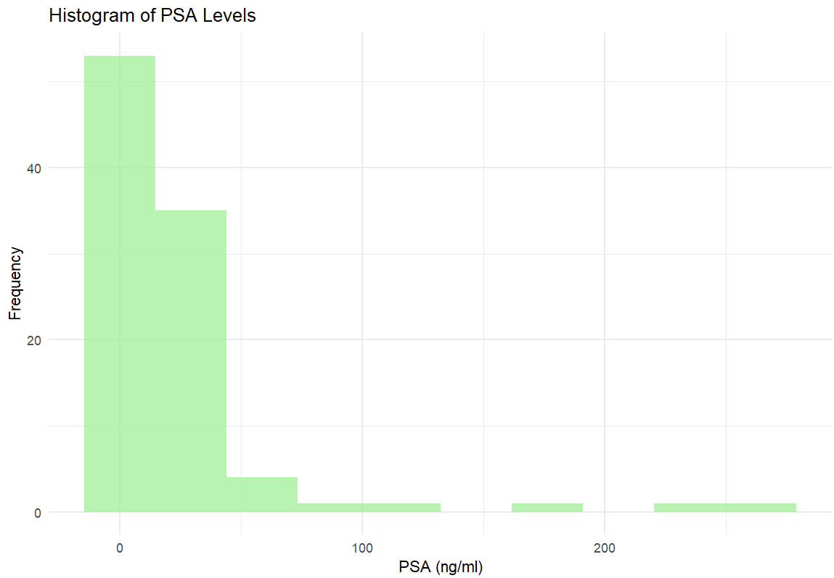
Dataset
Cancer Volume (Independent Variable):
Minimum: 0.26 cc, Maximum: 45.60 cc, Mean: 6.99 cc and Median: 4.26 cc.
The mean is higher than the median, suggesting a positively skewed distribution with a few large outliers.
PSA (dependent Variable):
Minimum: 0.65 ng/ml, Maximum: 265.07 ng/ml, Mean: 23.73 ng/ml and Median: 13.33 ng/ml.
The mean is higher than the median, suggesting a positively skewed distribution with a few large outliers.

Slide 4
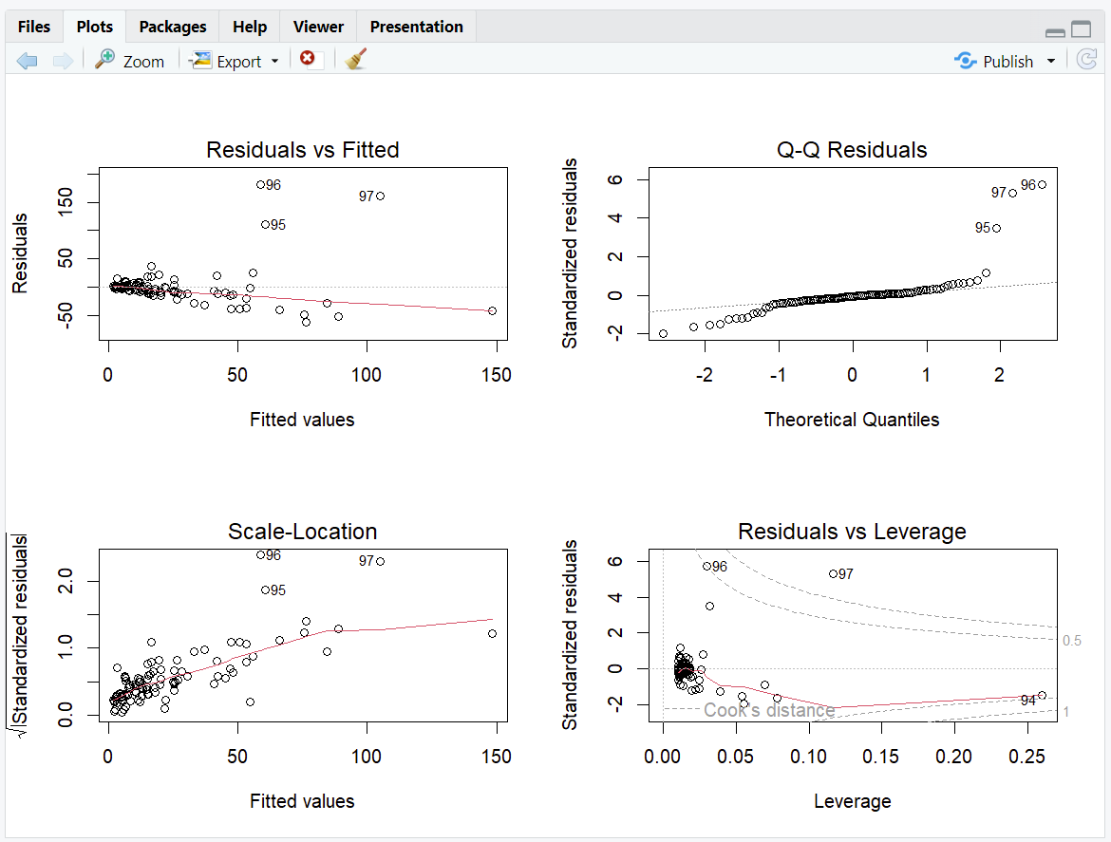

Initial Model
Model: PSA(Y) = β0+β1⋅Cancer Volume(X) + ϵ
Adjusted $R^{2}=0.38$
Residual Standard Error = 32.03
Predict PSA levels based on Cancer Volume using simple linear regression.

Slide 5
Diagnostic Plots:
Residuals vs Fitted Values:
Funnel shape observed, indicating heteroscedasticity.
Outliers (IDs: 95, 96, 97) are visible and may influence the model significantly.
Q-Q Plot:
Residuals deviate from the theoretical quantiles, especially in the tails.
Indicates that residuals are not normally distributed, violating regression assumptions.
Scale-Location Plot:
Variance increases with fitted values, confirming heteroscedasticity.
Outliers (IDs: 95, 96, 97) are prominent.
Residuals vs Leverage Plot:
Observations 95, 96, and 97 have high leverage and Cook's distance values.
These influential points could distort the regression line.

Slide 6
Conclusions from Initial Model:
The initial model violates key regression assumptions:
Non-normal residuals.
Heteroscedasticity.
Influence of outliers.
Remedial measures like transformations and outlier removal are necessary to improve the model.

Slide 7
Transformations and Remedial Measures

Slide 8
Outliers:
Observations 95, 96, and 97 were identified as influential outliers based on diagnostic plots
Outliers cause heteroscedasticity and non-normality of residuals, invalidating key regression assumptions.
These points distort the regression line, reducing predictive accuracy for the majority of data points.
Removing outliers reduces distortion, resulting in a model that better represents the underlying relationship between Cancer Volume and PSA.

Slide 9
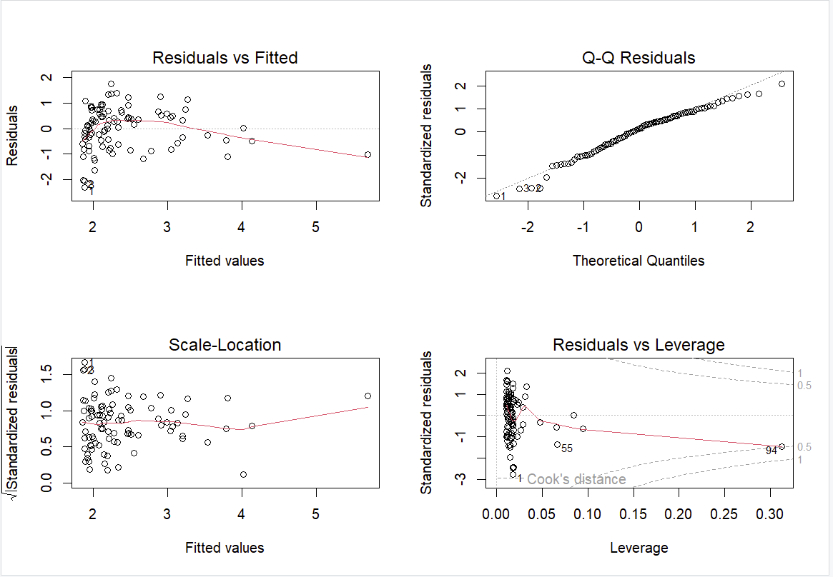

Log Transformation of PSA
Applied log transformation to stabilize variance and improve normality log(PSA) = β0+β1⋅Cancer Volume(X) + ϵ
Adjusted $R^{2}=0.35$
Residual Standard Error = 0.8404

Slide 10
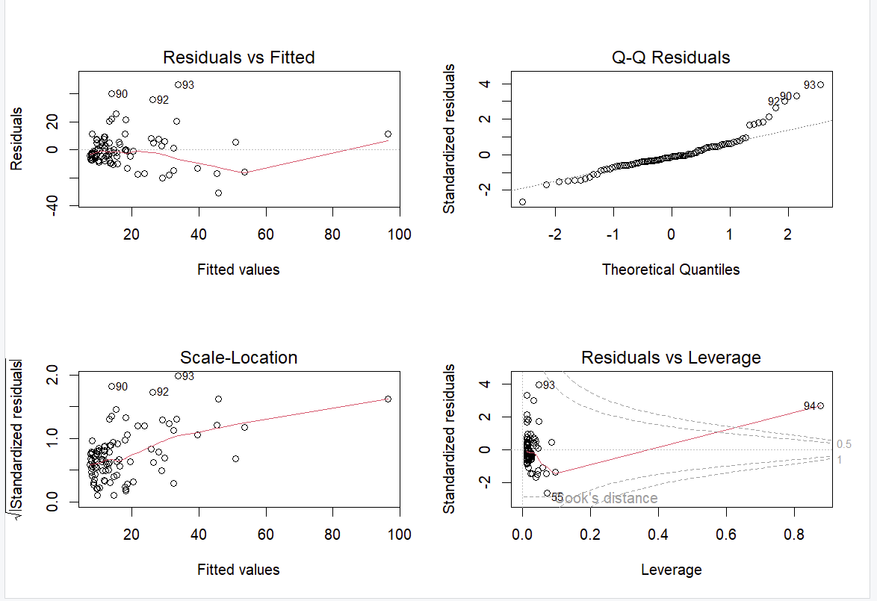

Polynomial Regression
Polynomial regression adds higher-order terms to capture potential non-linear relationships. PSA = β0+β1⋅${(Cancer Volume)}^{2}$+ ϵ
Adjusted $R^{2}=0.5298$
Residual Standard Error = 12.16

Slide 11
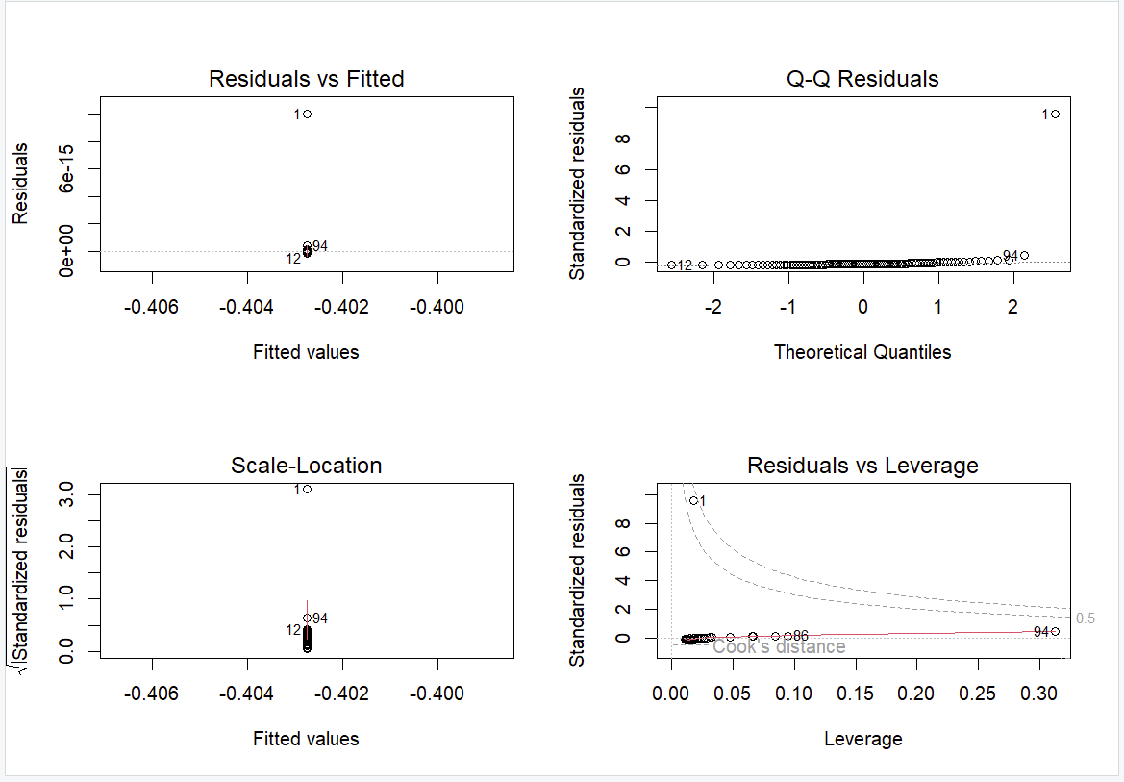

Box-Cox Transformation
Box-Cox systematically identifies the optimal power transformation for the dependent variable (PSA). ${PSA}_{transformed}$ = β0+β1⋅Cancer Volume + ϵ
Optimal λ ≈ 0.3 (close to log transformation λ=0).
${PSA}_{transformed}$ = $\frac{{PSA}^{0.3}−1}{0.3}$
Adjusted $R^{2}=0.49$
Residual Standard Error =1.057e-15

Slide 12
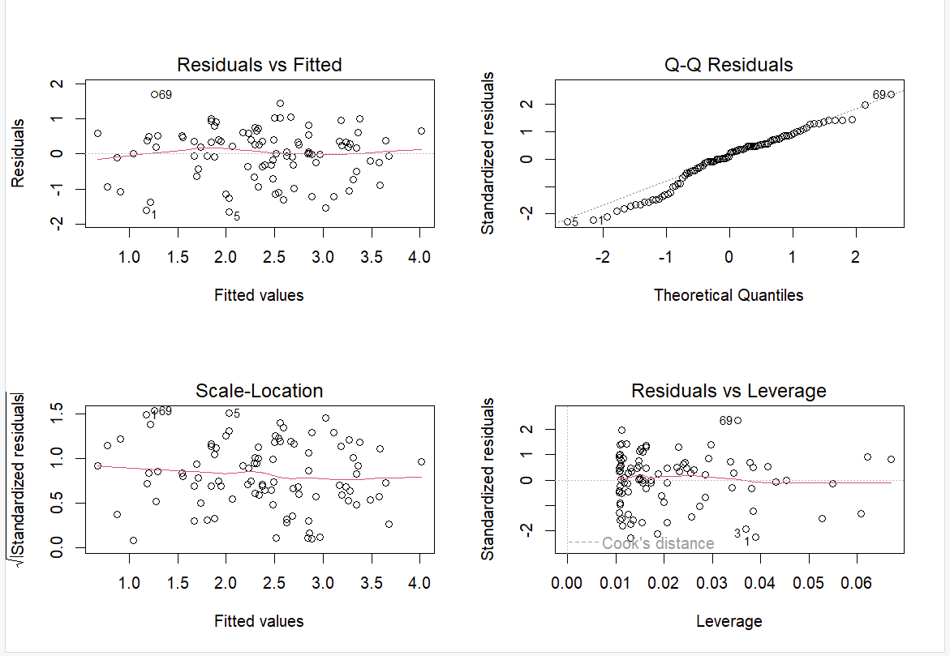

Log - Log Transformation
Applies a logarithmic transformation (λ=0) to both PSA and Cancer Volume. log(PSA) = β0+β1⋅log(Cancer Volume) + ϵ
Adjusted $R^{2}=0.51$
Residual Standard Error = 0.734

Slide 13
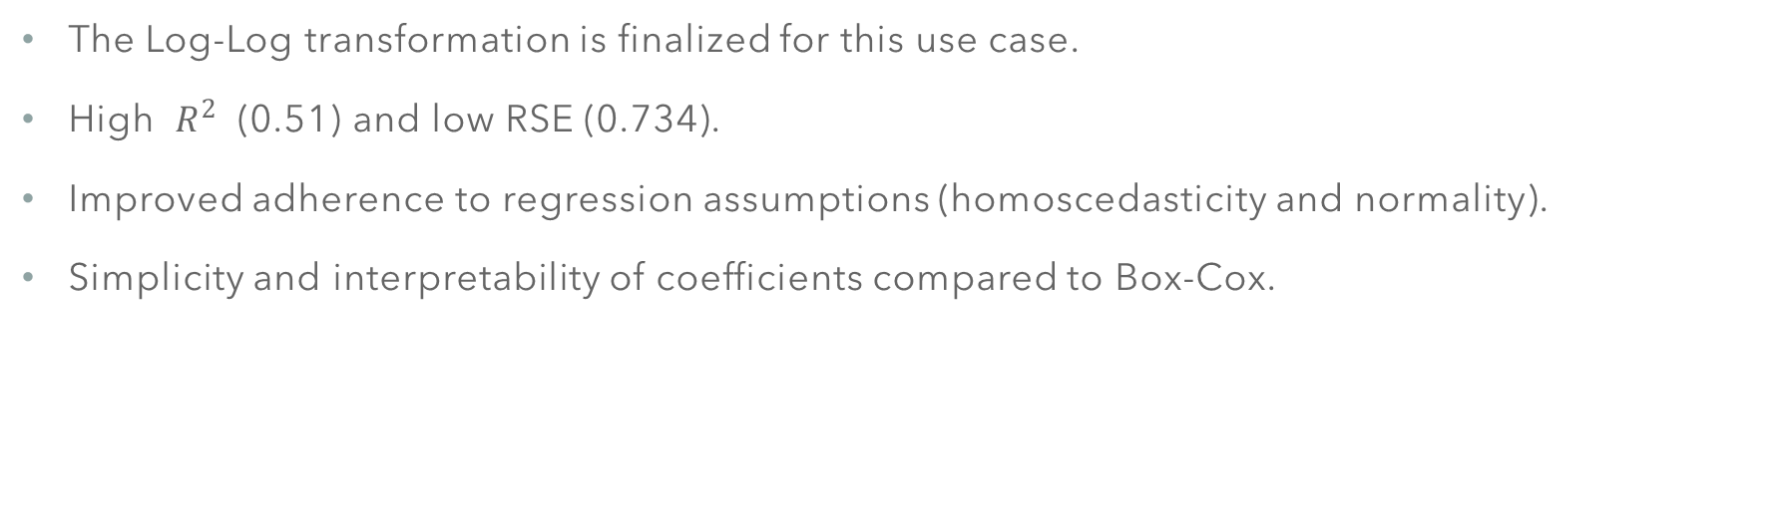
Finalized Model:
The Log-Log transformation is finalized for this use case.
High $R^{2}$ (0.51) and low RSE (0.734).
Improved adherence to regression assumptions (homoscedasticity and normality).
Simplicity and interpretability of coefficients compared to Box-Cox.

Slide 14

Prediction for Cancer Volume at 20cc
Calculation:
Log-transform Cancer Volume: log(Cancer Volume) = log(20)=2.9957
Use the regression equation from the log-log model: log(PSA) = β0+β1⋅log(Cancer Volume)
β0 = 1.54928
β1 = 0.64606
log(PSA) = 1.54928+(0.64606⋅2.9957) log(PSA) = 3.485
${PSA}_{Predicted}$ = elog(3.485) ${PSA}_{Predicted}$= 32.61 ng/ml
Using the finalized log-log model to predict the mean PSA level for a patient with a cancer volume of 20 cc.
Predicted PSA level for a cancer volume of 20 cc is 32.61 ng/ml.

Slide 15
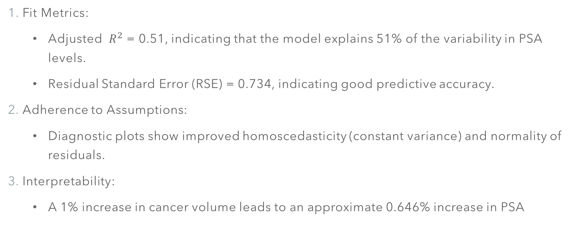
Strengths:
Fit Metrics:
Adjusted $R^{2}$ = 0.51, indicating that the model explains 51% of the variability in PSA levels.
Residual Standard Error (RSE) = 0.734, indicating good predictive accuracy.
Adherence to Assumptions:
Diagnostic plots show improved homoscedasticity (constant variance) and normality of residuals.
Interpretability:
A 1% increase in cancer volume leads to an approximate 0.646% increase in PSA

Slide 16
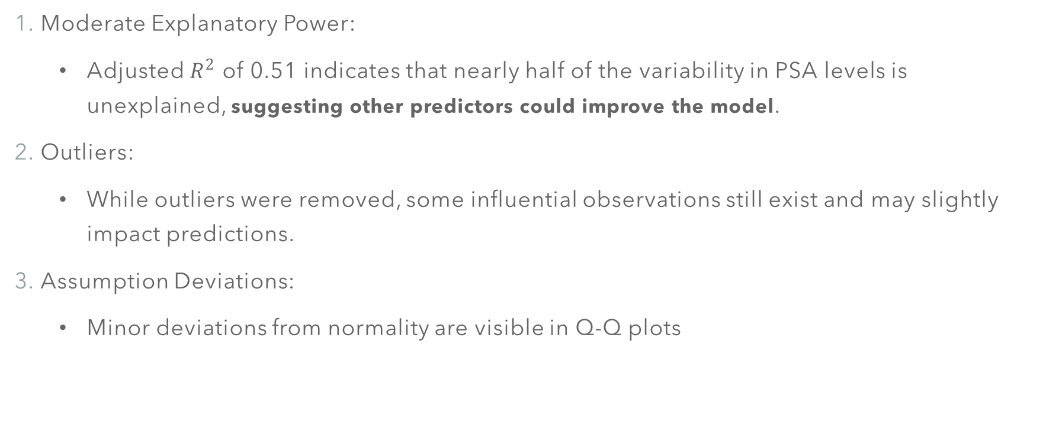
Weaknesses:
Moderate Explanatory Power:
Adjusted $R^{2}$ of 0.51 indicates that nearly half of the variability in PSA levels is unexplained, suggesting other predictors could improve the model.
Outliers:
While outliers were removed, some influential observations still exist and may slightly impact predictions.
Assumption Deviations:
Minor deviations from normality are visible in Q-Q plots

Slide 17
Thank you
Group - 9
D. Sharmendra
J. Tarun Kumar
M. Sri Varsha

